Slide 1
CS-GY 6313 B: Information Visualization
9/12/2024

Slide 2

Programming experience
tinyurl.com/f6sby8su

Slide 3
Office hours

Slide 4
Example Final Projects
https://drive.google.com/file/d/1VMIuv29u4wwjghJalscGvCDYK0XALxPD/view
https://mbtaviz.github.io/
https://www.washingtonpost.com/graphics/2020/world/corona-simulator/
Your implementation of an existing research paper

Slide 5
Data Types

Slide 6
Data types
Need to process data with a computer. What does it look like? How can we organize it?

Slide 7
Data types
5 basic data types:
Items
Attributes
Links
Positions
Grids
Provides a “language” that we can use to organize data viz concepts
Notes:
Item is an individual, discrete entity
Attribute is some property (of an individual) that can be measured
Links are relatinoships between items, usually for networks
Position is spatial data that specifies a location in 2D or 3D.
Grid specifies the strategy for sampling continuous data that make up the items

Slide 8
Dataset types
Collection of data → dataset
Can be static or dynamic
Tables
Items
Attributes
Networks
Items (nodes)
Links
Attributes
Fields
Grids
Positions
Attributes
Geometry
Items
Positions
Attributes (sometimes)
Notes:
Difference between fields and geometry is that fields are attribute-focused, while geometry data sets are not.
Fields are about how the continuous attribute changes over some area, but geometry is about the precise structure of some object

Slide 9
Dataset types: Tables
Much of the data we consider in life can be arranged in a table
Country | Year | Population | Case
A | 2020 | 10 | 1
A | 2021 | 11 | 2
B | 2020 | 50 | 3
B | 2021 | 55 | 5

Slide 10

Dataset types: Tables
Each variable must have its own column
Each observation must have its own row
Each value must have its own cell
Rule of thumb:
Variables often map to aesthetics
Observations can be compared

Slide 11
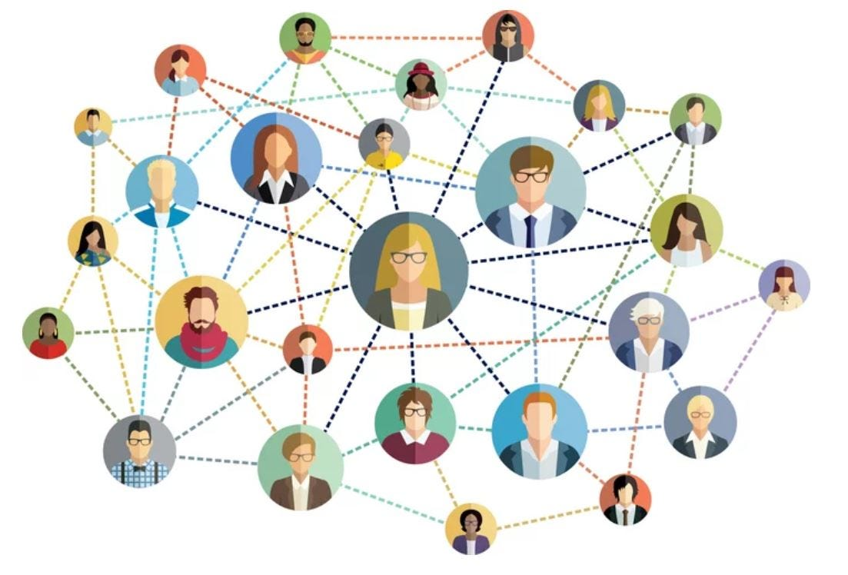
Dataset types: Networks
Good for specifying relationships between items
A node is an item in a network (vertex)
A link is a relation between two items (edge)
Nodes and links often have attributes
Do not have to be related
Examples:
Social network
Computer network
Gene interaction network

Slide 12
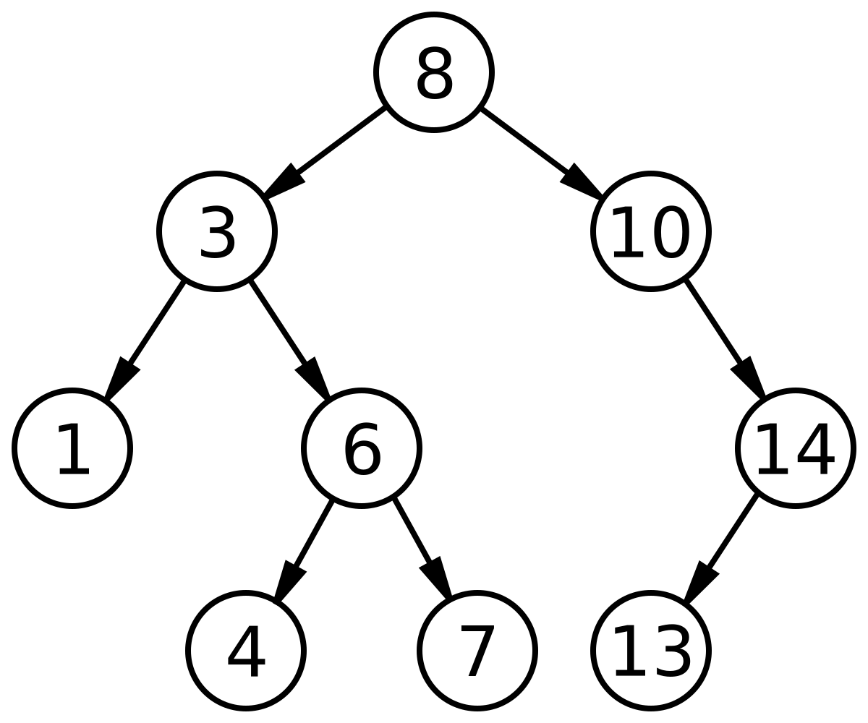
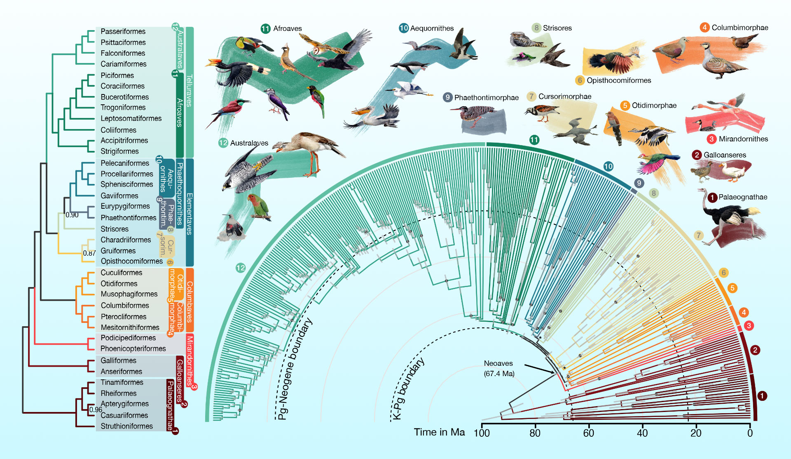
Dataset types: Networks - Trees
A tree is a special type of network
Trees have hierarchical structure

Slide 13
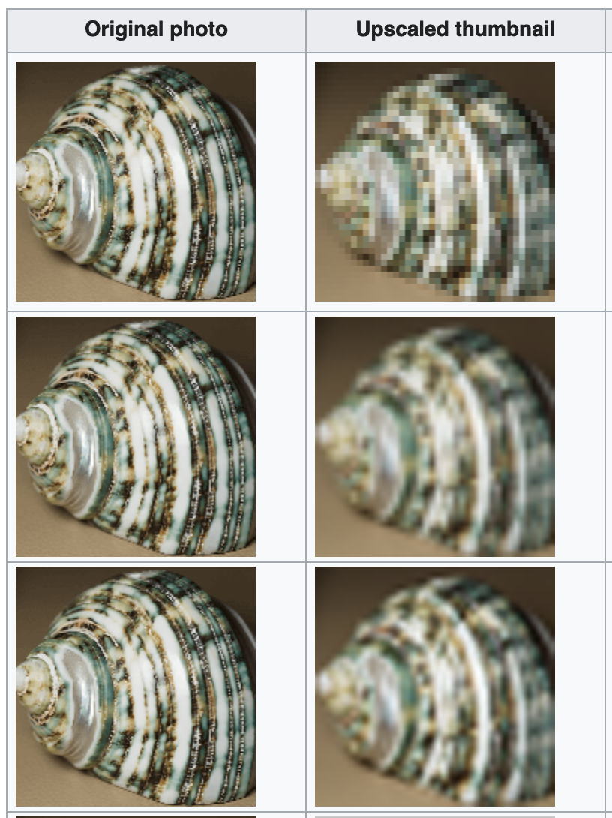
Dataset types: Fields
Each cell is a measurement/calculation from a continuous domain
Infinite number of possible measurements, but fields discretize the domain
Sampling strategy is important
Don’t want to mislead the reader
Interpolation can help (can be misleading!)

Slide 14
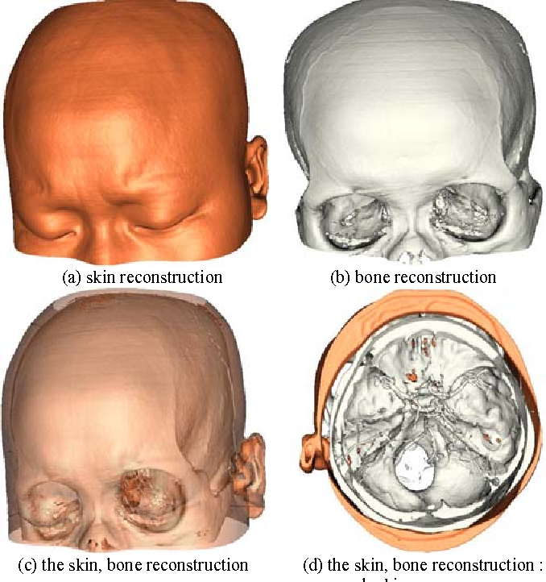
Dataset types: Fields
Each cell is a measurement/calculation from a continuous domain
Infinite number of possible measurements, but fields discretize the domain
Sampling strategy is important
Don’t want to mislead the reader
Interpolation can help (can be misleading!)
Examples:
Medical scans

Slide 15
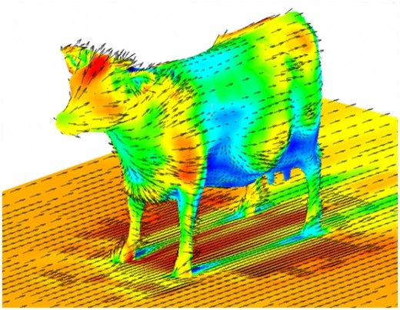
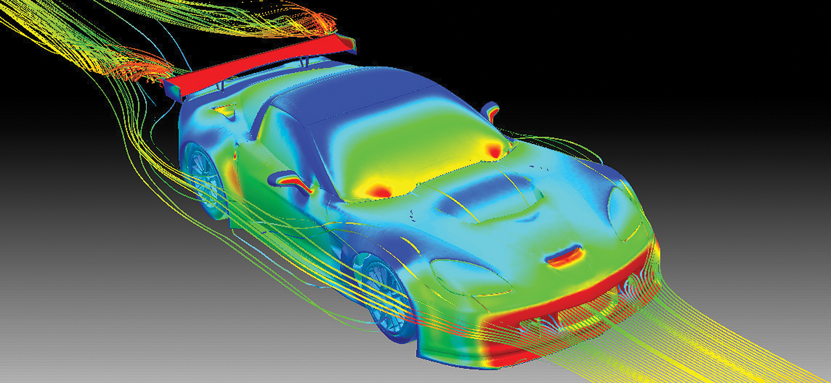
Dataset types: Fields
Each cell is a measurement/calculation from a continuous domain
Infinite number of possible measurements, but fields discretize the domain
Sampling strategy is important
Don’t want to mislead the reader
Interpolation can help (can be misleading!)
Examples:
Medical scans
Aerodynamics data

Slide 16
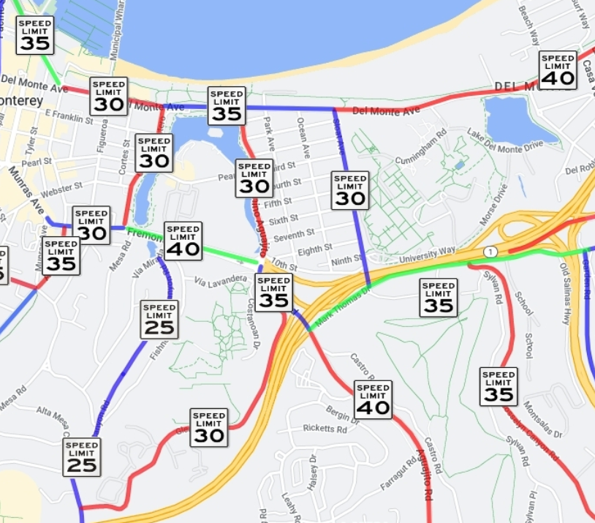
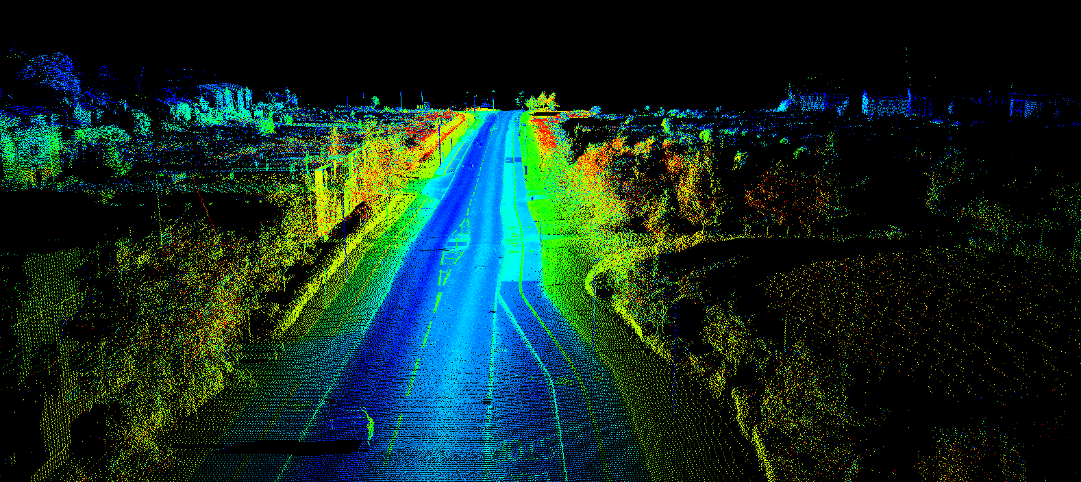
Dataset types: Geometry
Specifies info about the shape of items
Explicit spatial positions
Intrinsically spatial (like fields)
May or may not have attributes!
Examples: Roads, Lidar scans
Notes:
With attributes:
Road network: lines representing road segments, with attributes (road name, road type, speed limit)
Without attributes:
Elevation data: the positions specify points in space, and those points inherently specify the elevation
Lidar point clouds: points representing the surface features

Slide 17
Attribute types
Attributes are the measured properties of items
Person’s height
Density of a cloud
Annual rainfall for a country
Usually maps onto visual aesthetics of the viz

Slide 18

Attribute types
Different kinds of attributes
Attribute Types
Ordering Direction
Categorical
Sequential
Ordered
Diverging
Ordinal
Quantitative
Cyclic

Slide 19
Attribute types: Categorical (nominal)
Does not have an implicit ordering
Also called nominal data
Can still be a number, but doesn’t make sense to aggregate
Examples:
Dog breeds (hierarchical!)
Song genres
City names

Slide 20
Attribute types: Ordered
Ordered data has an implicit ordering
Ordinal
Has an order but differences between categories may not be equal/measurable
Example:
Likert scale (questionnaire responses)
Quantitative
Supports arithmetic, differences between values are measurable
Interval data: We can derive the gap between data values, and it has meaning
Ratio data: Similar to interval data, but has a true zero that has meaning. Allows math operations
Example:
1, 2, 3, 4, 5.4, 345.2221, 17366105.23872, 1000000000000

Slide 21
Attribute types: Ordered
Data may have different types of ordering
Sequential: Values have a minimum and a maximum
Example: Person’s height
Diverging: Values can be divided into 2 sequences pointing in opposite directions, meeting at a common zero point
Example: Terrain elevation (sea level = 0)
Cyclic: Values wrap around back to a starting point
Example: Hour of the day

Slide 22
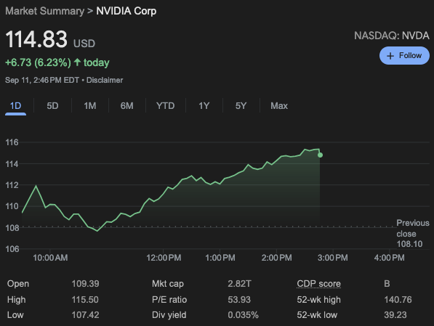
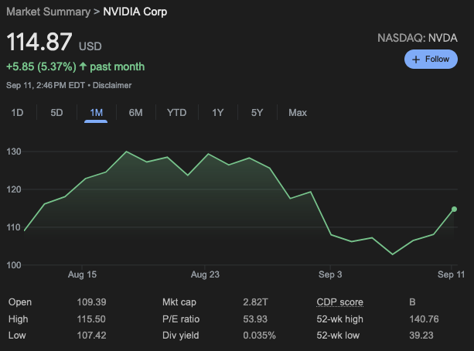
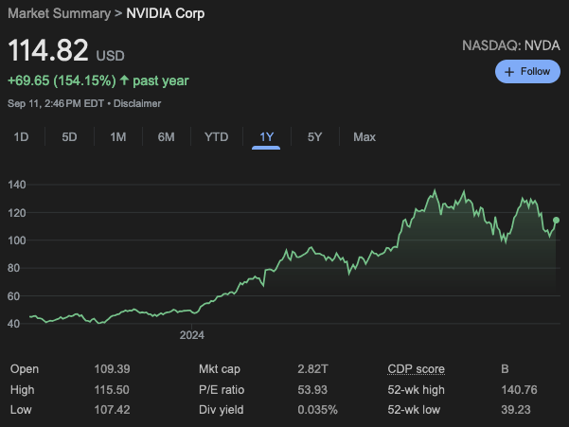
Attribute hierarchies
Attributes can often be grouped hierarchically
Interesting patterns may emerge at different hierarchy levels
Example: stock price

Slide 23
Attribute types
Also makes sense to group into dependent and independent
Independent attributes:
Way of describing the data
Usually discrete (i.e., categorical)
Dependent attributes:
Their value is a function of one or more independent variables
Numerical data that can be analyzed, manipulated, and aggregated

Slide 24
Metadata
Data about data
Can be difficult to visualize since it adds complexity
Underlying task of visualization remains the same, though

Slide 25
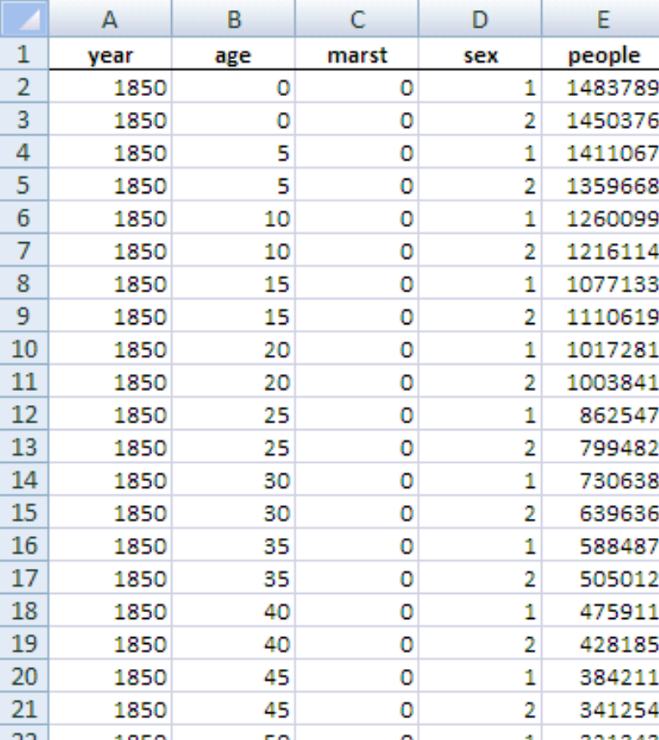
Exercise: US Census
What are the types of these attributes?
Categorical, ordinal, or quantitative (ratio or interval)?
Dependent or independent?
Talk with your neighbor for ~2 min
People count: # of people in group
Year: 1850 – 2000 (every decade)
Age: 0 – 90+
Sex: male, female
Marital status: single, married, divorced
Notes:
People count: quantitative (ratio)
Year: quantitative (interval) or ordinal
Age: quantitative (ratio) or ordinal
Sex: categorical
Marital status: categorical

Slide 26
Exercise: US Census
What are the types of these attributes?
Categorical, ordinal, or quantitative (ratio or interval)?
Dependent or independent?
Talk with your neighbor for ~2 min
People count: quantitative (ratio)
Year: quantitative (interval) or ordinal
Age: quantitative (ratio) or ordinal
Sex: categorical
Marital status: categorical

Slide 27
Exercise: US Census
What are the types of these attributes?
Categorical, ordinal, or quantitative (ratio or interval)?
Dependent or independent?
Talk with your neighbor for ~2 min
People count: dependent
Year: independent
Age: dependent (?)
Sex: independent
Marital status: independent (?)

Slide 28
5 Minute Break resume @ 11:58am

Slide 29
Visualization techniques
We have the data, now how do we show it to someone?
What are our options?
How do we implement these options?

Slide 30
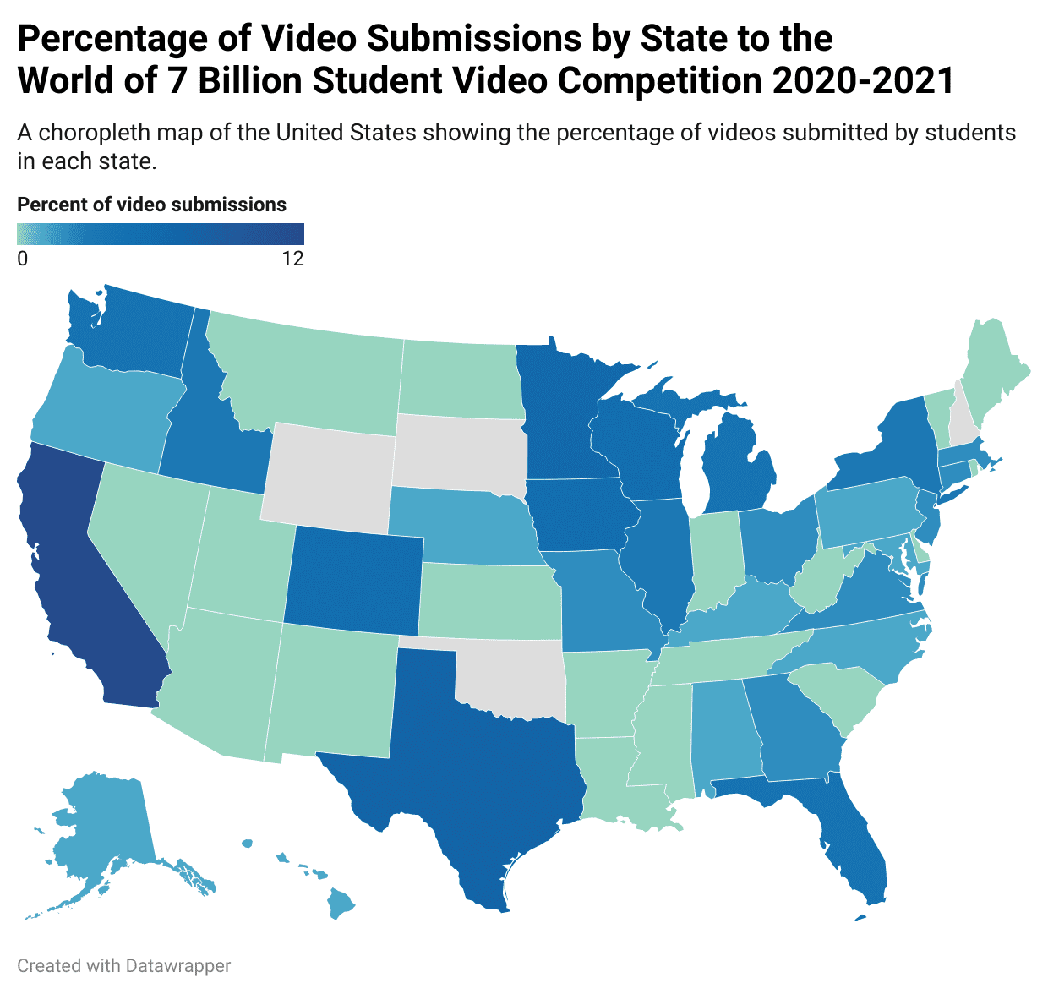
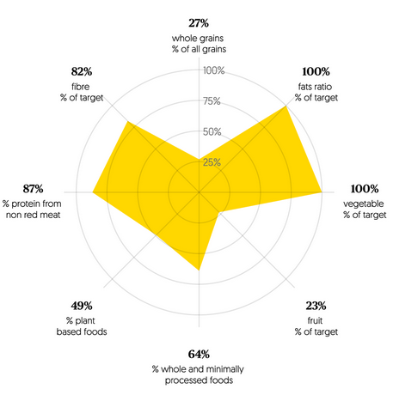
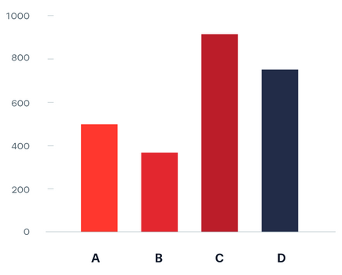
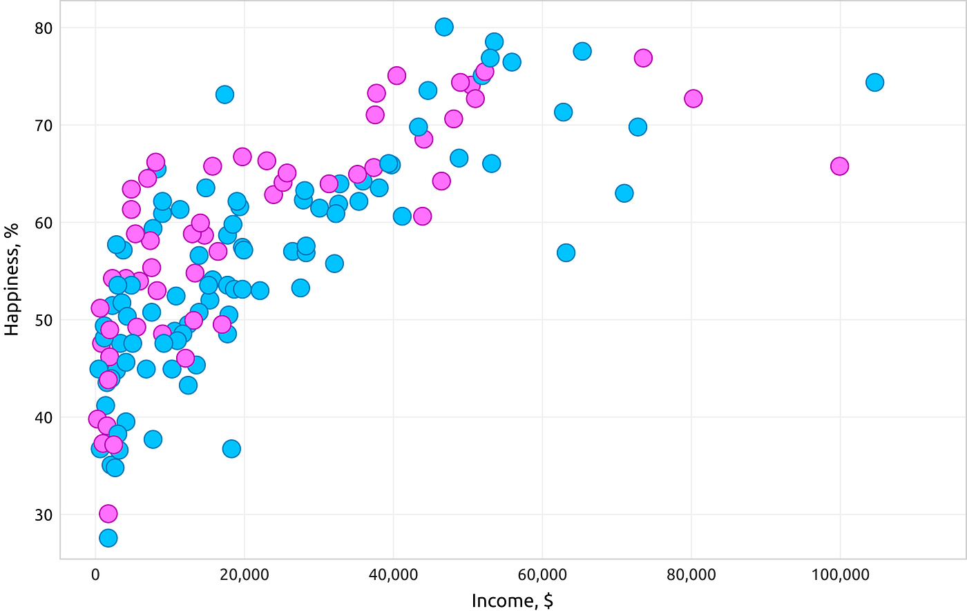
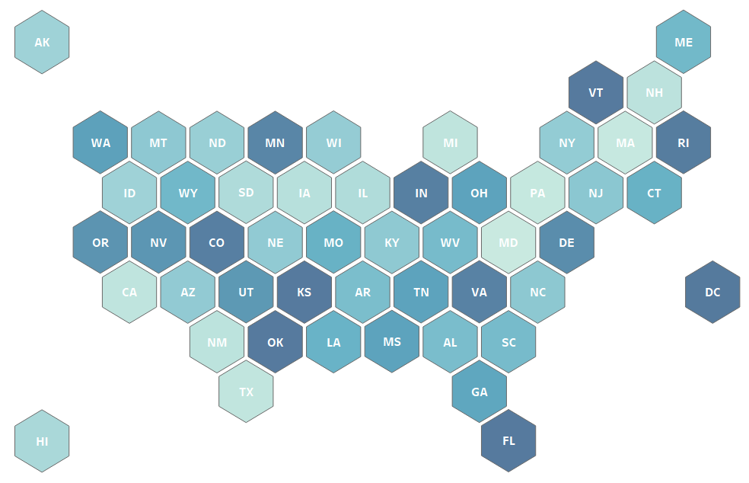
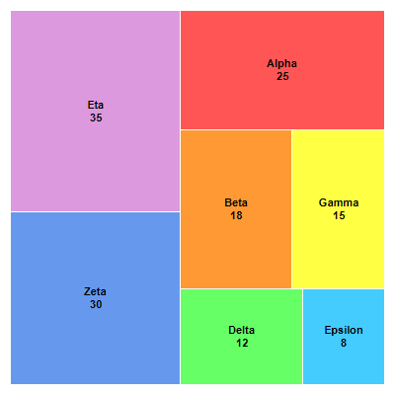
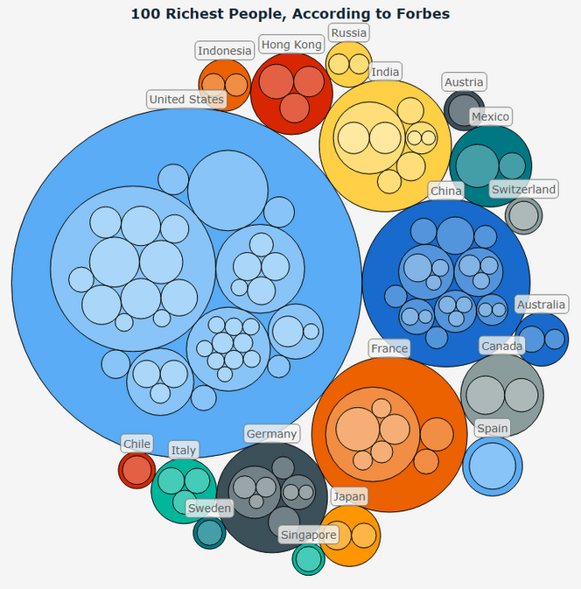
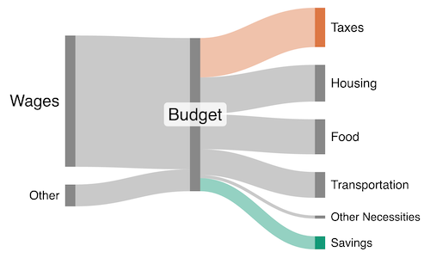
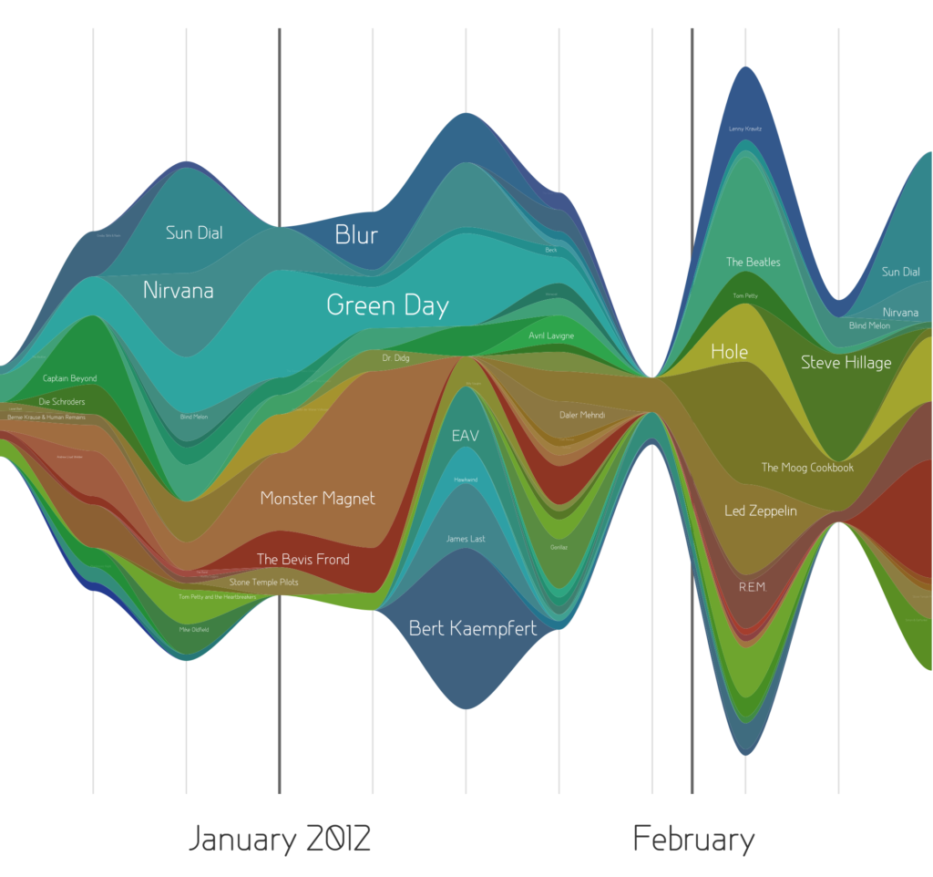
Visualization techniques

Slide 31
Python + matplotlib
https://colab.research.google.com/drive/1PJqGp_v-cKx62hC0ba9g2zzxzJ8NySVq?usp=sharing

Slide 32
Python + bokeh
https://colab.research.google.com/drive/1SYAirRVHoGK-zxXyMn4VT0yONMEDiY8-?usp=sharing

Slide 33
LaTeX crash course
Essentially a Markup Language (like HTML, XML and RTF)
Invented in the 70s by Donald Knuth
He was writing a book, but there were no good typesetting solutions, so he made his own!
You should use https://www.overleaf.com/
Requires internet connection, but avoids somewhat annoying installation + compile process

Slide 34
LaTeX vs Word processors
High typeset quality
Easy to include math formulas
Source file format id not bounded to a particular OS or platform
Latex implementations exists for all platforms (DOS, Windows, Unices,..)
Latex is free

Slide 35
LaTeX vs Word processors
De facto standard for scientific publishing
Very few bugs
Good for large documents
Not very easy to learn 🙁

Slide 36
LaTeX file structure
Document Class
Predefined Formats (article, report, book,..)
Packages used
Added Functionality (graphics, reference style,...)
Main Body
Text and Bibliography References

Slide 37
LaTeX basics
Document class
\documentclass[options]{class}
options = a4paper, 11pt, 12pt, 10pt, twocolumn, landscape,...
class = article, report, book,...
Packages
\usepackage{package name}
epsfig = insert PS pictures into the document
fancyhdr = easy definition of footer and header

Slide 38
Body of text
Start with \begin{document}
End with \end{document}
Typesetting Text
\\ or \newline and \newpage
Quotations use backtick (`) and apostrophe (‘)
Bold \textbf{……………} or \bf
Italics \emph{…………} or \textit{………} or \it
Underline \underline{…………} or \ul

Slide 39
Organizing a document
Sections
\section{Latex is Great} = 1. Latex is Great
\subsection{Why Latex is Great} = 1.1 Why Latex is Great
\subsubsection{Reason One} = 1.1.1 Reason One
\appendix - changes numbering scheme
\chapter{…} - To be used with book and report document classes
Titles, authors, and others
\title{…}
\author{…}
\footnote{…}
Labels
\label{marker} - Marker in document.
\ref{marker} - Displays section location of marker.

Slide 40
Lists
LaTeX source:
\begin{itemize}
\item Apple
\item Orange
\end{itemize}
Result:
Apple
Orange
Enumerate instead of itemize gives a numbered list
Lists can be nested
\begin{...} is called an environment in LaTeX
Itemize, figure, table, enumerate, etc

Slide 41
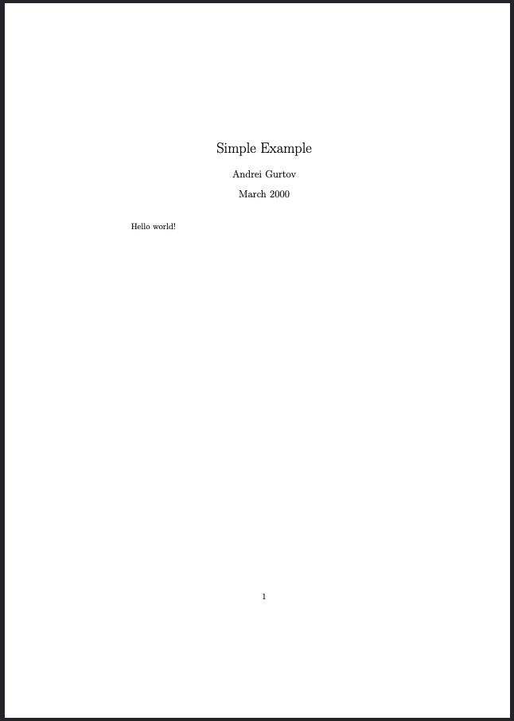
Example document
\documentclass{article}
\title{Simple Example}
\author{Andrei Gurtov}
\date{March 2000}
\begin{document}
\maketitle
Hello world!
\end{document}

Slide 42
Tables
\begin{tabular}{|l|r|c} \hline
Date & Price & Size \\ \hline
Yesterday & 5 & big \\ \hline
Today & 3 & small \\ \hline
\end{tabular}

Slide 43
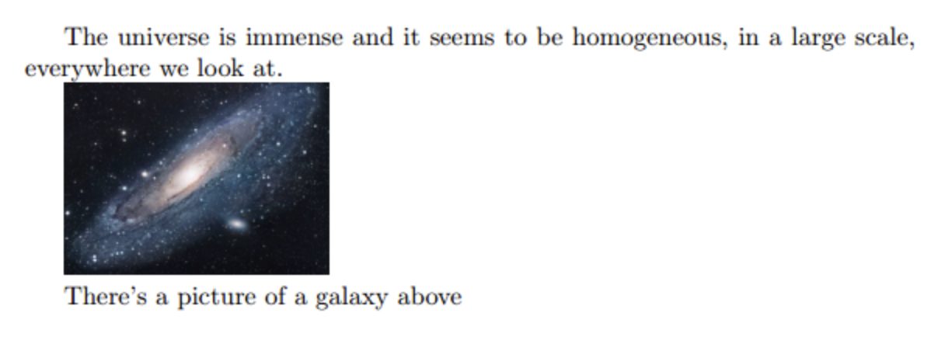
Figures
\usepackage{graphicx}
\graphicspath{ {./images/} }
\begin{document}
The universe is immense and it seems to be homogeneous, in a large scale, everywhere we look at.
\includegraphics{universe}
There's a picture of a galaxy above
\end{document}

Slide 44
Bibliography
Bibliography information is stored in a *.bib file, in Bibtex format.
Include chicago package
\usepackage{chicago}
Set referencing style
\bibliographystyle{chicago}
Create reference section by
\bibliography{bibfile with no extension}

Slide 45
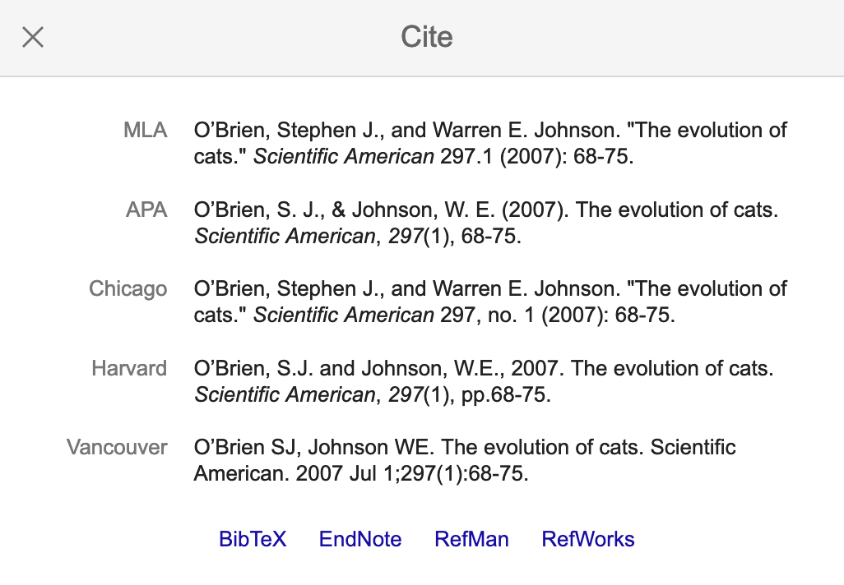
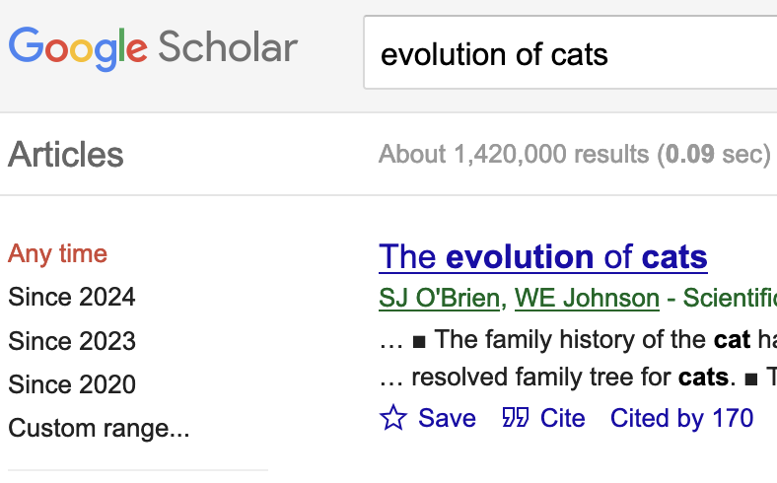
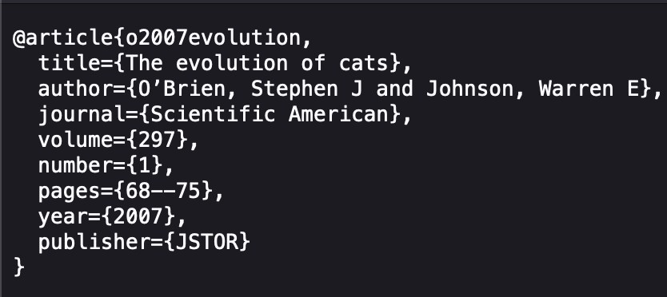
Bibliography
Citing references in text
\cite{cuc98} = (Cuce 1998)
\citeN{cru98} = Crud (1998)
\shortcite{tom98} = (Tom, et. al. 1998)
Creating Bibtex Files

Slide 46
TODO
TODO

